Slide 1
Introduction to Database Systems
CSC424
Lecture #1
Feb. 2nd, 2016
Prof. Zhanyang Zhang

Slide 2
Why We Need Database?
Trace back to human early civilization
  Hunters and gathers using ropes and beans
  Early democracy (Greek voting system)
Today’s Business World
  Financial, hospital, university, etc …
  Can you name a business that does not use data or database?

Slide 3
Database Models
Relational database – all data are organized into tables (ie. Relations).
Norelational database – all database that are not relational (ie. Network model, hieratical model, object-oriented model, XML, etc …

Slide 4
What Is a Relational Database Management System ?
Database Management System = DBMS
Relational DBMS = RDBMS
A collection of files that store the data
A big C program written by someone else that accesses and updates those files for you

Slide 5
Where are RDBMS used ?
Backend for traditional “database” applications
Backend for large Websites
Backend for Web services

Slide 6
Example of a Traditional Database Application
Suppose we are building a system
to store the information about:
students
courses
professors
who takes what, who teaches what

Slide 7
Can we do it without a DBMS ?
Sure we can! Start by storing the data in files:
students.txt courses.txt professors.txt
Now write C or Java programs to implement specific tasks

Slide 8
Doing it without a DBMS...
Enroll “Mary Johnson” in “CSE444”:
Write a C program to do the following:
  Read ‘students.txt’
  Read ‘courses.txt’
  Find&update the record “Mary Johnson”
  Find&update the record “CSE444”
  Write “students.txt”
  Write “courses.txt”

Slide 9
Problems without an DBMS...
System crashes:
  What is the problem ?
Large data sets (say 50GB)
  What is the problem ?
Simultaneous access by many users
  Need locks: we know them from OS, but now data on disk; and is there any fun to re-implement them ?
  Read ‘students.txt’
  Read ‘courses.txt’
  Find&update the record “Mary Johnson”
  Find&update the record “CSE444”
  Write “students.txt”
  Write “courses.txt”
CRASH !

Slide 10

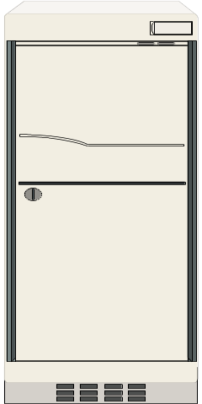


Enters a DMBS
“Two tier database system”
connection
(ODBC, JDBC)
Database server
(someone else’s
C program)
Data files
Applications

Slide 11
Functionality of a DBMS
The programmer sees SQL, which has two components:
Data Definition Language - DDL
Data Manipulation Language - DML
  query language
Behind the scenes the DBMS has:
Query optimizer
Query engine
Storage management
Transaction Management (concurrency, recovery)

Slide 12
How the Programmer Sees the DBMS
Start with DDL to create tables:
Continue with DML to populate tables:
CREATE TABLE Students (
Name CHAR(30)
SSN CHAR(9) PRIMARY KEY NOT NULL,
Category CHAR(20)
) . . .
INSERT INTO Students
VALUES(‘Charles’, ‘123456789’, ‘undergraduate’)
. . . .

Slide 13
Different Type of DBMS Users
Data Architect Users
DBA (database administrators)
Direct DB Users – using SQL to query database.
No-direct DB Users – using a third party software application to access database.
Database Programming Users – write software to allow others to access database for certain business applications

Slide 14
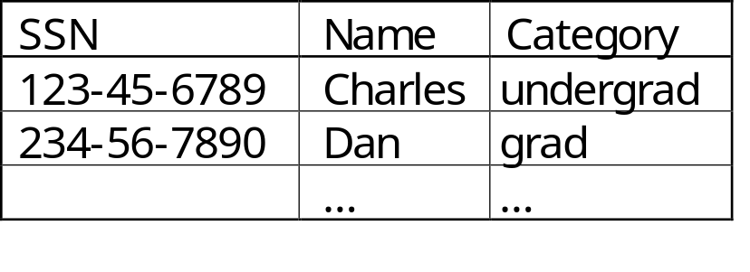
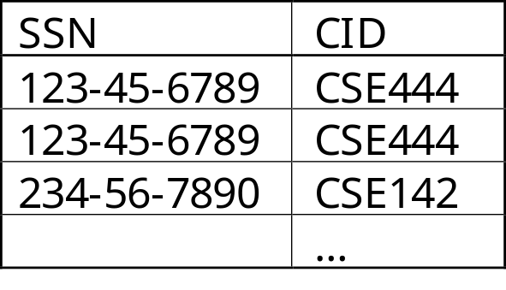
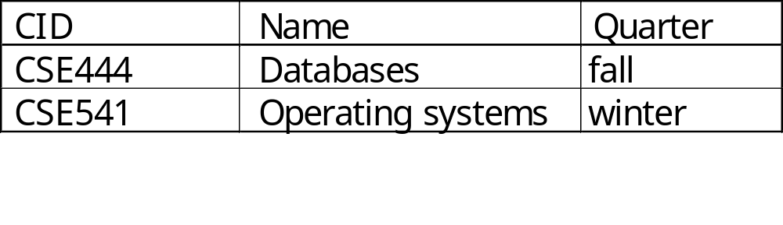
How the Programmer Sees the DBMS
Tables:
Still implemented as files, but behind the scenes can be quite complex
Students:
Takes:
Courses:
“data independence” = separate logical view
from physical implementation

Slide 15
Transactions
Enroll “Mary Johnson” in “CSE444”:
BEGIN TRANSACTION;
INSERT INTO Takes
SELECT Students.SSN, Courses.CID
FROM Students, Courses
WHERE Students.name = ‘Mary Johnson’ and
Courses.name = ‘CSE444’
-- More updates here....
IF everything-went-OK
THEN COMMIT;
ELSE ROLLBACK
If system crashes, the transaction is still either committed or aborted

Slide 16
Transactions
A transaction = sequence of statements that either all succeed, or all fail
Transactions have the ACID properties:
  A = atomicity
  C = consistency
  I = independence
  D = durability

Slide 17
Queries
Find all courses that “Mary” takes
What happens behind the scene ?
  Query processor figures out how to answer the query efficiently.
SELECT C.name
FROM Students S, Takes T, Courses C
WHERE S.name=“Mary” and
S.ssn = T.ssn and T.cid = C.cid

Slide 18
Database Systems
The big commercial database vendors:
  Oracle
  IBM (with DB2) bought Informix recently
  Microsoft (SQL Server)
  Sybase
Some free database systems (Unix) :
  Postgres
  Mysql
  Predator
In CSC424 we use MySql. You may use something else, but you are on your own.

Slide 19
New Trends in Databases
Object-relational databases
Main memory database systems
XML XML XML !
  Relational databases with XML support
  Middleware between XML and relational databases
  Native XML database systems
  Lots of research here at UW on XML and databases
Data integration and Big Data Analytical/Informatics
Peer to peer, stream data management – still research

